Slide 1
File Construction Workshop NTTP, XIII-D, XIII-O, PT Kerri Sowers, Fall 2024

Slide 2
Today’s Session
Important Resources
File Construction
Questions

Slide 3
Important Resources
Locally Negotiated Agreements
Faculty Evaluation Procedure MOA
Faculty Evaluation Policy (University Standards – section 6.00 and 10.0)
Program Standards
School Standards
Online Course MOA
Personnel Actions Calendar
Summary Due Dates
NTTP MOA (2023)

Slide 4
Important Dates
File Closing
January 3: NTTP Year 1-4, NTTP Year 5, XIII-O, PT Year 1-4, PT Year 5, and PT After Year 5
February 4: XIII-D
PRC Letters
January 14: NTTP Year 1-4, NTTP Year 5, XIII-O, PT Year 1-4, PT Year 5, and PT After Year 5
February 18: XIII-D
Dean Letters
January 21: NTTP Year 1-4, NTTP Year 5, XIII-O, PT Year 1-4, PT Year 5, and PT After Year 5
March 11: XIII-D
FRC Letters
Only if needed, January 28: NTTP Year 1-4, PT Year 1-4, and PT After Year 5
Required, January 28: NTTP Year 5, PT Year 5
Provost, February 4
President, February 11
BOT, March 4
Rebuttals are due 3 days after each level of review, by 2 PM

Slide 5
NTTP & PT: Review Periods
NTTP
Year 1 through 4 are annual reviews by the PRC and Dean (goes to FRC only if negative)
Year 5 is a review by the PRC, Dean, FRC, and Provost
If appointed for a sixth year, you are then eligible for two- or three-year contracts
Subsequent reviews go to the PRC and Dean (only negative reviews go to the FRC/Provost)
May apply for promotion to a higher rank (see section G in the NTTP MOA 2023) or for a range adjustment (see 2024 Addendum)
Part-Time
Year 1 through 4 are annual reviews by the PRC and Dean (goes to FRC only if negative)
Year 5 is a review by the PRC, Dean, FRC, and Provost
If appointed for a sixth year, you are then eligible for two-year contracts
Subsequent reviews go to the PRC and Dean (only negative reviews go to the FRC/Provost)
May apply for promotion to a higher rank (during promotion cycle)

Slide 6
XIII-D & XIII-O: Review Periods & Conversion
XIII-D
One-year contract, not permitted to extend beyond three years
XIII-O
May be a two- or three-year contract
XIII-D and XIII-O
Same evaluation process as a first-year tenure track faculty
If converted to a tenure track, the years will count towards the tenure clock
If appointed to a tenure track line for Year 2
One-year contract
Must create a faculty plan in Year 2
Follow the evaluation process for Year 2 faculty
If appointed to a tenure track line for Year 3
Two-year contract
A faculty plan is not required but may be done informally
Year 3 file (feedback evaluation) will follow the MOA procedure for the First Year Feedback review process.

Slide 7
File Construction Approach
NTTP, XIII-D, XIII-O, and PT files are due by 5 PM on January 3rd and XIII-D is due February 4th
Review MOA, Policy, & Standards
Consider your audience (PRC, Dean, possibly FRC, Provost, President)
Gather artifacts/evidence of excellence
Engage in thoughtful self-reflection
Utilize FAWN

Slide 8
NTTP Evaluation
Evaluation based on contract terms and the NTTP MOA
Criteria for Evaluation: The criteria for evaluation of NTTPs will be based on the terms of individual contract(s) and should include but are not limited to:
1. Evidence of excellence in teaching effectiveness, including professional development to maintain currency in their subject matter as well as their teaching skills/abilities.
2. Evidence of excellence in meeting service responsibilities
3. Any additional documentation specified in the University, School, and Program Standards with the exception of those related to scholarship and/or creative activity.

Slide 9
NTTP File Contents
Files of First Year NTTPs
A short (one-page) reflection on their first semester at Stockton
Syllabi and student evaluations for first semester courses
If assigned teaching, NTTPs are expected to have a peer observation in their first semester and include that report in their file
If assigned other duties, NTTPs are expected to provide relevant documentation of job performance
Files of all other NTTPs
A self-evaluation of no more than 5-pages (overall assessment of the NTTPs’ achievements in teaching, service, and/or other contractual duties, as assigned)
If applicable, they should include a Teaching Portfolio with representative syllabi, student evaluations of teaching, two peer-observation reports per year, evaluations of precepting, any optional documentation of teaching excellence, and documentation of service.
NTTPs are expected to provide relevant documentation of job performance.

Slide 10
NTTP “Advancement” (aka Promotion)
NTTP Advancement
Eligible for advancement to a higher level after 5 years of consecutive service
Must meet/exceed the requirements of the higher level (except in the area of scholarship/creative work)
Promotion will result in advancement of 3 salary ranges
Must submit written application for consideration of promotion following the normal promotional cycle for full-time faculty, identified in the Personnel Actions Calendar, on or before November 1 (accompanied by necessary documentation and evidence)
External reviewers are not required for advancement to any level

Slide 11
NTTP Range Adjustment
NTTP Range Adjustment
Have qualifications that meet or exceed two of the three requirements for seeking advancement to the next level (Policy II-10.5, sections 10.2-10.3.3)
Documentation of scholarship/creative activity is not required
External reviewers are not required
Eligible to apply after 7 years of consecutive service
Must provide 2 peer observations of teaching and/or clinical performance by a multi-contract NTTP or tenured faculty
Follow the range adjustment cycle/timeline
Range adjustment will result in advancement of 2 salary ranges

Slide 12
Required File Content
Background Materials
File cover page & position description/responsibilities (School uploads)
Updated Curriculum Vitae (CV)
Self-Evaluation
Executive Summary (1-2 pages)
NTTP Narrative: self-evaluation of their contributions to teaching, and service
PT, XIII-D, XIII-O Narrative: brief self-evaluation of contributions to teaching, scholarship/creative activity, and service

Slide 13
Required File Content
Teaching Portfolio (REQUIRED CONTENT)
Representative syllabi
IDEA/small class instrument
Peer observation(s) – optional PT, XIII-O, XIII-D (recommended if there is a possibility to convert to tenure track), required for NTTP
NTTP 1st year – 1 required
NTTP 2-5 years – 2 per year
NTTP after 5 years, on a multi-year contract – not required, unless seeking advancement/range adjustment
Precepting survey – should include if you have preceptees,
Optional additional materials (sample assignments, lectures, rubrics, class feedback, etc.)
Provide evidence and reflect about how you have met University, School, and Program standards

Slide 14
Required File Content
Scholarship Evidence (OPTIONAL NTTP – evidence to support your narrative)
Samples of scholarly or creative work(s)
Evidence of reviews, grants, or awards
Provide evidence and reflect about how you have met University, School, and Program standards
Service Evidence (NTTP REQUIRED)
Evidence of awards
Letters that document impact of service (external and internal)
Notice of committee appointments
Task force/committee reports, meeting notes, other evidence that documents service contributions
Provide evidence and reflect about how you have met University, School, and Program standards

Slide 15
Mistakes to Avoid
Missing or inaccurate CV information
Not considering the readers when writing (consider clarity, brevity, & specificity)
Failing to reference the standards for excellence in teaching, service, and scholarship
Failing to provide evidence
Not connecting your evidence to your self-evaluation
Teaching philosophy not supported by evidence
No examples from IDEAs or overreliance on IDEA scores
Lack of reflection/examination of trends (IDEA & other assessments)

Slide 16
Uploading File Content
Login Instructions
Upload = Slow process

Slide 17
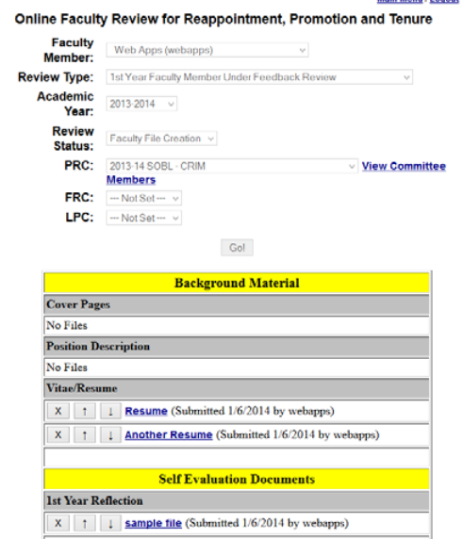
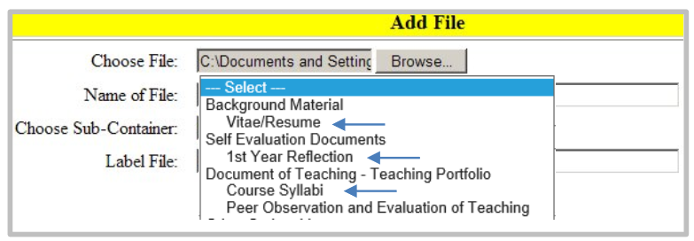
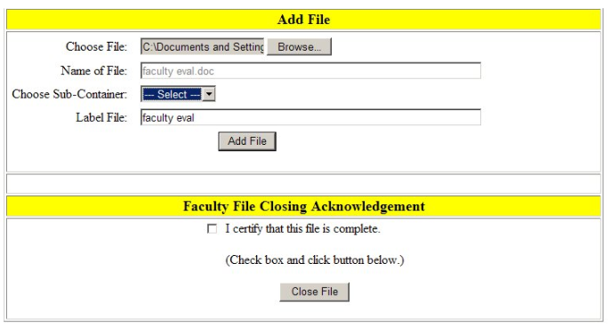

Slide 18
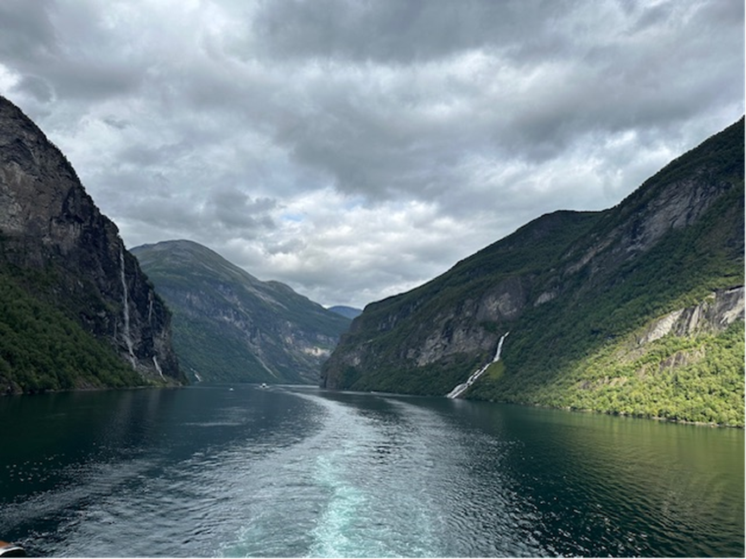
Questions??

