Slide 1
File Construction Workshop Range Adjustment Kerri Sowers, Fall 2024

Slide 2
Today’s Session
Important Resources
Range Adjustment File Construction
Questions

Slide 3
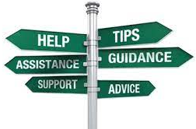
Important Resources
Locally Negotiated Agreements
Faculty Evaluation Procedure MOA
Faculty Evaluation Policy (University Standards – section 6.00 and 10.0)
Program Standards
School Standards
Online Course MOA
Personnel Actions Calendar
Summary Due Dates

Slide 4
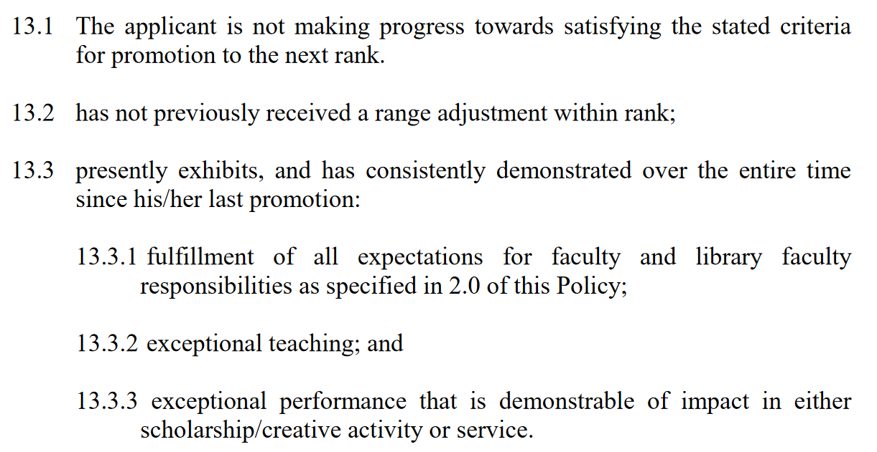
Criteria for Range Adjustment
Stockton University Faculty Evaluation Policy (2016, page 22)

Slide 5
NTTP Range Adjustment
NTTP Range Adjustment
Have qualifications that meet or exceed two of the three requirements for seeking advancement to the next level (Policy II-10.5, sections 10.2-10.3.3)
Documentation of scholarship/creative activity is not required
External reviewers are not required
Eligible to apply after 7 years of consecutive service
Must provide 2 peer observations of teaching and/or clinical performance by a multi-contract NTTP or tenured faculty
Follow the range adjustment cycle/timeline
Range adjustment will result in advancement of 2 salary ranges
Stockton University Faculty Evaluation Policy (2016, page 22)

Slide 6
Range Versus Promotion
Range Adjustment
Based on teaching AND service OR scholarship
You are meeting the standards in your current rank
Files are submitted early spring semester
Promotion
Based on teaching, service, AND scholarship
You are meeting the standards for the next highest rank
Files submitted early fall semester
Plan for external review process
If you can’t decide between service or scholarship for your range file – consider promotion!!
Feedback from PRC/FRC
Distinguished professors are eligible for range adjustment
Professors should consider promotion to Distinguished
Only requires teaching and service OR scholarship
Minimum 10 years at rank of Professor
Program “politics” and other reasons people avoid applying for promotion

Slide 7
Procedure for Range Adjustment
Must notify the Dean of your intent to submit a file for range adjustment prior to the last teaching day of the fall semester
December 6, 2024
Electronic file organization and submission process (similar to T&P or promotion)
Review process
Faculty: PRC, Dean, FRC, Provost, President, BOT approval
Librarians: LPC, Director of the Library, Provost, President, BOT approval
Same procedures apply to Faculty Librarians
Notify the Director/Associate Director in place of the Dean
Faculty Evaluation MOA (2015, page 51)

Slide 8
Important Dates: Range Adjustment
Dean notification and file opening: December 6, 2024
File closing: January 14, Faculty (January 7, Library Faculty)
PRC (LPC) Review: February 4 (February 11)
Dean Review: February 18
FRC (Direct Supervisor) Review: March 11 (March 4)
Provost Review: April 1 (March 25)
President Review: April 24 (April 1)
BOT Approval: May 7
Rebuttals are due 3 days after each level of review, by 2 PM

Slide 9
File Construction Approach
Range Adjustment file is due by 5 PM on January 14th (or January 7 for Library Faculty)
Review MOA, Policy, & Standards
Consider your audience (PRC/LPC, Dean, FRC/Direct Supervisor, Provost, President)
Gather artifacts/evidence of excellence
Engage in thoughtful self-reflection
Utilize FAWN

Slide 10
Required Range Adjustment File Content
Background Materials
File cover page & position description/responsibilities (School uploads)
Updated Curriculum Vitae (CV)
Self-Evaluation
Executive Summary (1-2 pages)
Narrative - reflect on ACHIEVEMENT of standards in two areas (~15 pages):
Teaching
Service or Scholarship
Document and reflect on achievements that have occurred since your last personnel action

Slide 11
Required Range Adjustment File Content
Teaching Portfolio (since last personnel action)
Representative syllabi
Peer observation(s) – optional (not required)
IDEA/small class instrument
All results of past evaluations since the last positive personnel action OR the results from the last 5 years (whichever is shorter)
Tenured faculty are required to evaluate at least half of their course load within an academic year)
Optional for spring 2020 – Covid MOA (must cite)
Precepting survey
Optional additional materials (sample assignments, lectures, rubrics, class feedback, etc.)
Provide evidence and reflect about how you have met the standards

Slide 12
Required Range Adjustment File Content
Scholarship Evidence (since last personnel action)
Samples of scholarly or creative work(s)
Evidence of reviews, grants, or awards
External Review (optional for range adjustment – need to arrange reviewers in advance)
Provide evidence and reflect about how you have met the standards
OR
Service Evidence (since last personnel action)
Evidence of awards
Letters that document impact of service (external and internal)
Notice of committee appointments
Task force/committee reports, meeting notes, other evidence that documents service contributions
Provide evidence and reflect about how you have met the standards

Slide 13
Mistakes to Avoid
Missing or inaccurate CV information
Not considering the readers when writing (consider clarity, brevity, & specificity)
Failing to reference the standards for excellence in teaching and service OR scholarship
Failing to provide evidence
Not connecting your evidence to your self-evaluation
Teaching philosophy not supported by evidence
No examples from IDEAs or overreliance on IDEA scores
Lack of reflection/examination of trends (IDEA & other assessments)

Slide 14
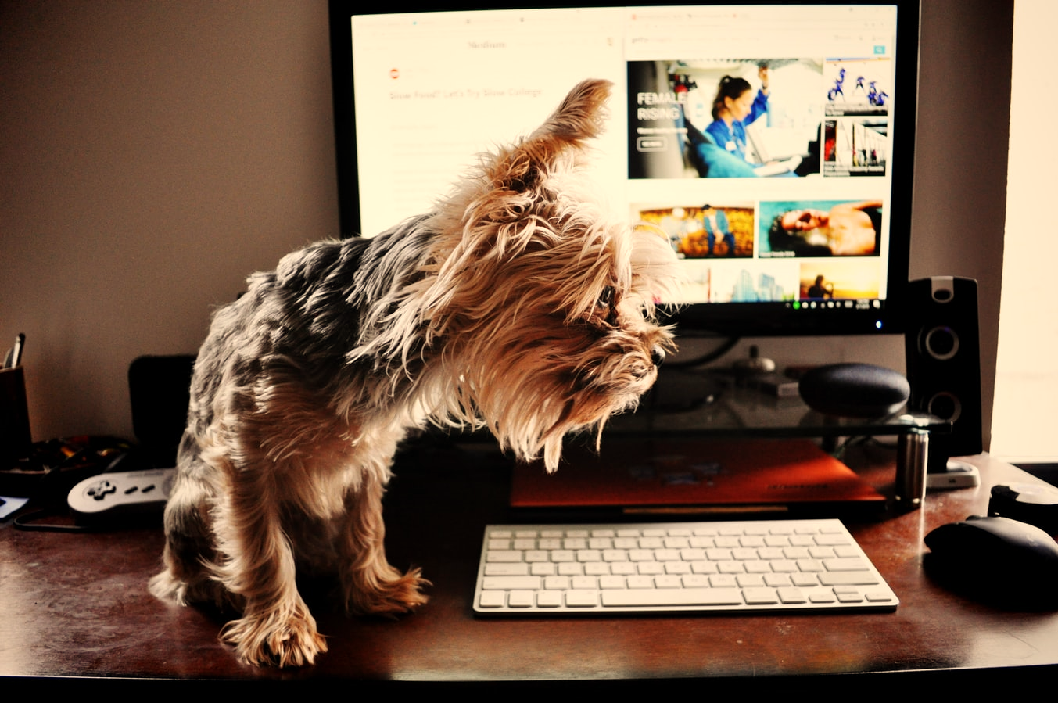
Uploading File Content
Login Instructions
Upload = Slow process

Slide 15
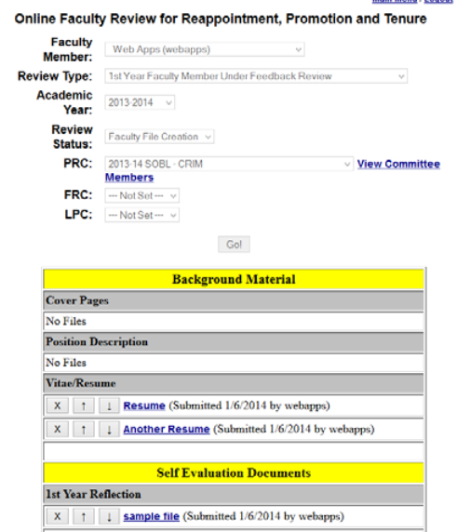
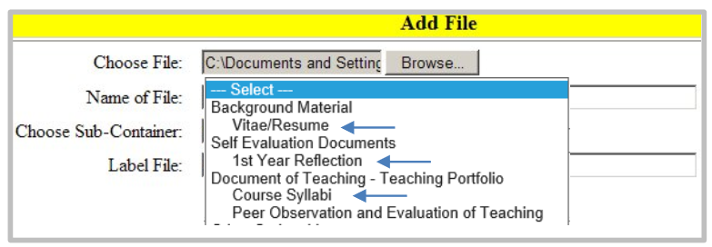
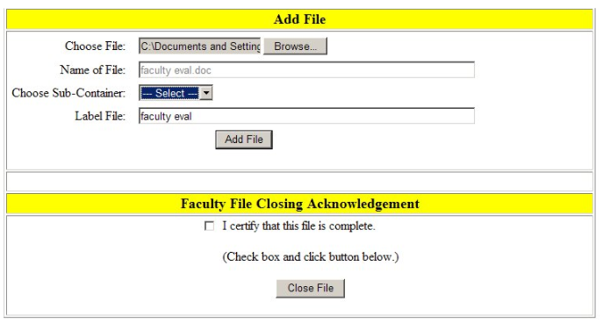

Slide 16
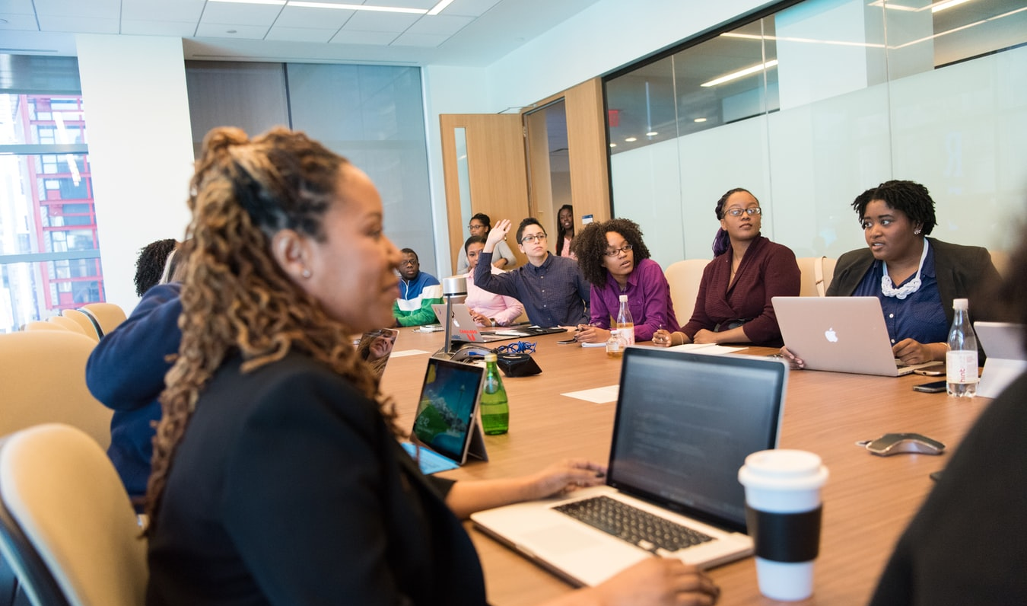
Levels of Review
Faculty decisions go to the PRC, Dean, FRC, Provost, and then President
If you have a PRC member who is serving on the FRC, they will be recused from the discussion and vote at FRC level
A program member (who was not on your PRC) is allowed to discuss and vote at the FRC level
If you are a PRC member, you will not be involved in other Range Adjustment decisions at the same rank
Librarian decisions got to the LPC, Direct Supervisor, Provost, President, BOT approval
You may write a rebuttal letter (get help from the Union!) after any level (you have 3 days to submit; rebuttals are due by 2 PM)

Slide 17
Successful Range Adjustment
If the President approves the application, a positive recommendation goes to the Board of Trustees for a two-range adjustment
If approved by the Board of Trustees, the merit-based range adjustment within rank will be effective at the beginning of the Fall semester following the action by the Board

Slide 18
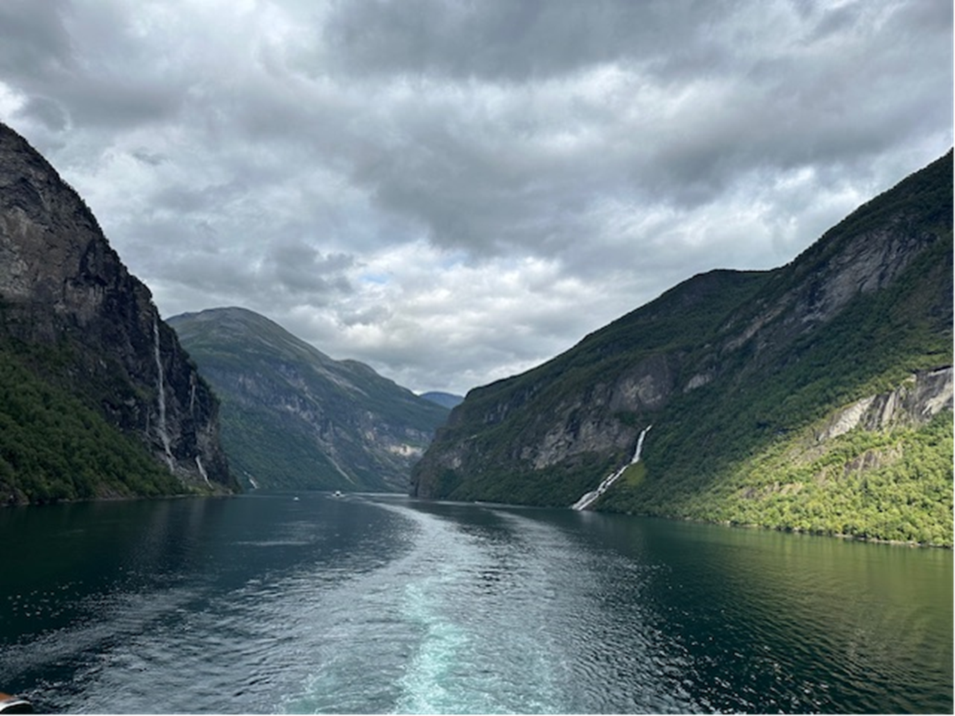
Questions??

